Slide 1


Visualization for the Impact of
Third Political Parties
Project
Brook Tarekegn Assefa, Hannah Koizumi, Naomi Ohashi
DS5110 Big Data Systems - Team 8
March 26, 2024

Slide 2
Agenda
Project Team
Project Proposal
Data
Methods & Improvements
Results
Conclusion & Future Experiments

Slide 3



Our Team and Roles
Brook Tarekegn Assefa
Coding Manager
Project Support
Hannah Koizumi
Materials Manager
Coding Support
Subject Area Expert
Naomi Ohashi
Project Manager
Materials Support

Slide 4
1. Research Question

Slide 5
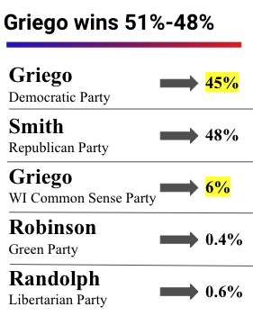
Project Background
The two party system defines American politics, but as it becomes clear that more voters want a third option, electoral reform efforts look at ways to make third parties viable.
Fusion voting is when a third party cross-nominates one of the two major party candidates, which is a way to make third parties relevant without spoiling elections.
There is a natural experiment happening over the past century, New York and Connecticut are the only two states where fusion voting is legal.
Reformers who recently became interested in relegalizing fusion voting want to compare the longevity, cost, and success of third parties in fusion states versus non-fusion states.

Slide 6
Key Questions
When comparing fusion vs non-fusion states between 2008-2022…
Do the number of third party candidates differ (avg/state) over time?
Do the lifespan of third parties differ?
Do third parties win more elections, year by year?
Do fusion candidates attract more small donor contributions (<$2,000)? (proxy for wider public support)

Slide 7
2. Data

Slide 8
Data
Candidate Funnel
Any filed candidate: FEC Data (U.S. House, 1976-2022)
Money Spent & Individual Contributions to Candidates: FEC Data (U.S. House, 1976-2022)
Election Outcome & Total Votes: MIT Data (U.S. House, 2008-2022)

Slide 9
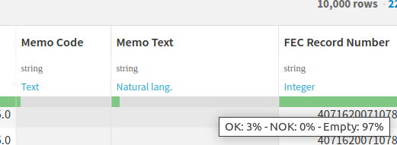
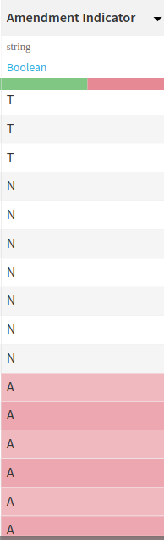
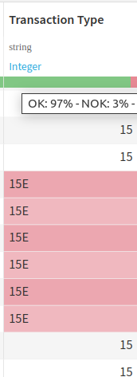
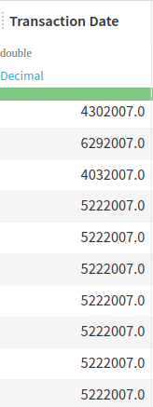
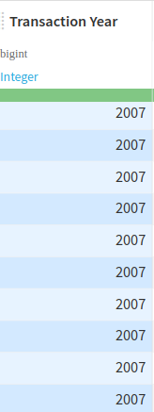
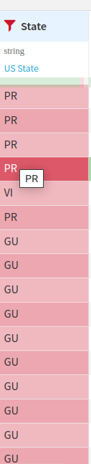
Data Wrangling & EDA
Column Removal
Type Mismatch
Mixed Types
Aggregations
Imputations
Notes:
For instance, PR stands for Puerto Rico, which is a U.S. territory rather than a state.
While residents of Puerto Rico are U.S. citizens, Puerto Rico itself is not a U.S. state but rather an unincorporated territory.

Slide 10
3. Experiment Process

Slide 11
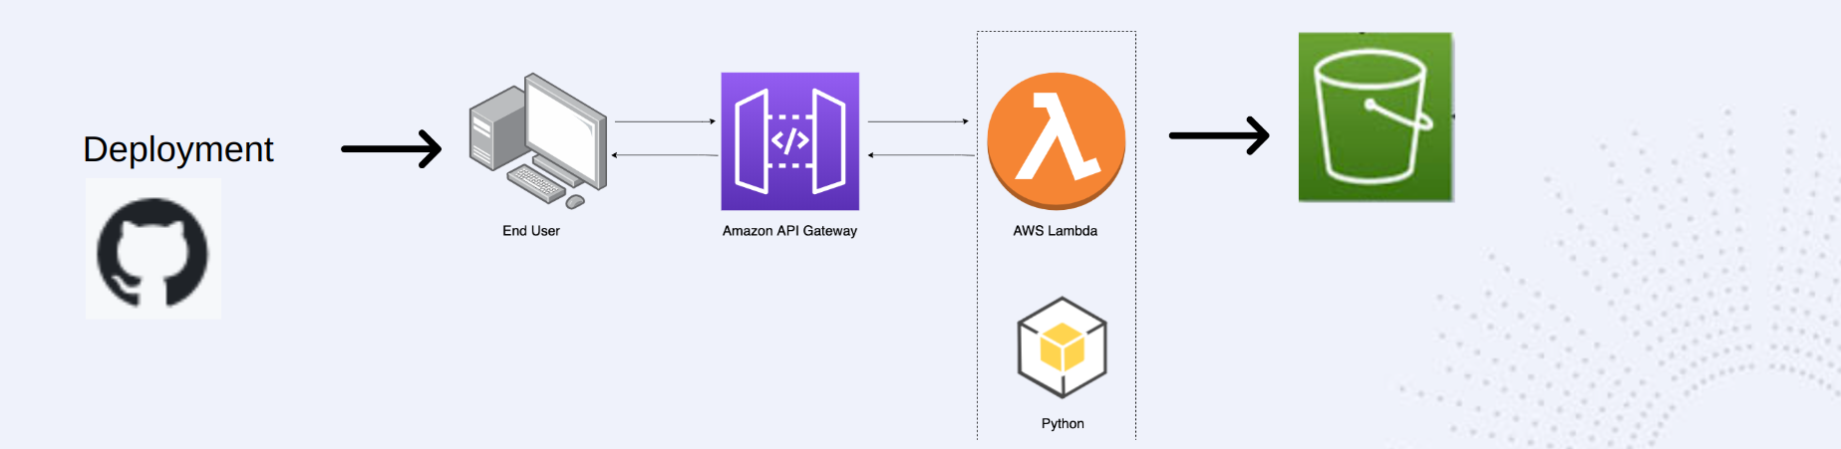
AWS Architecture

Slide 12
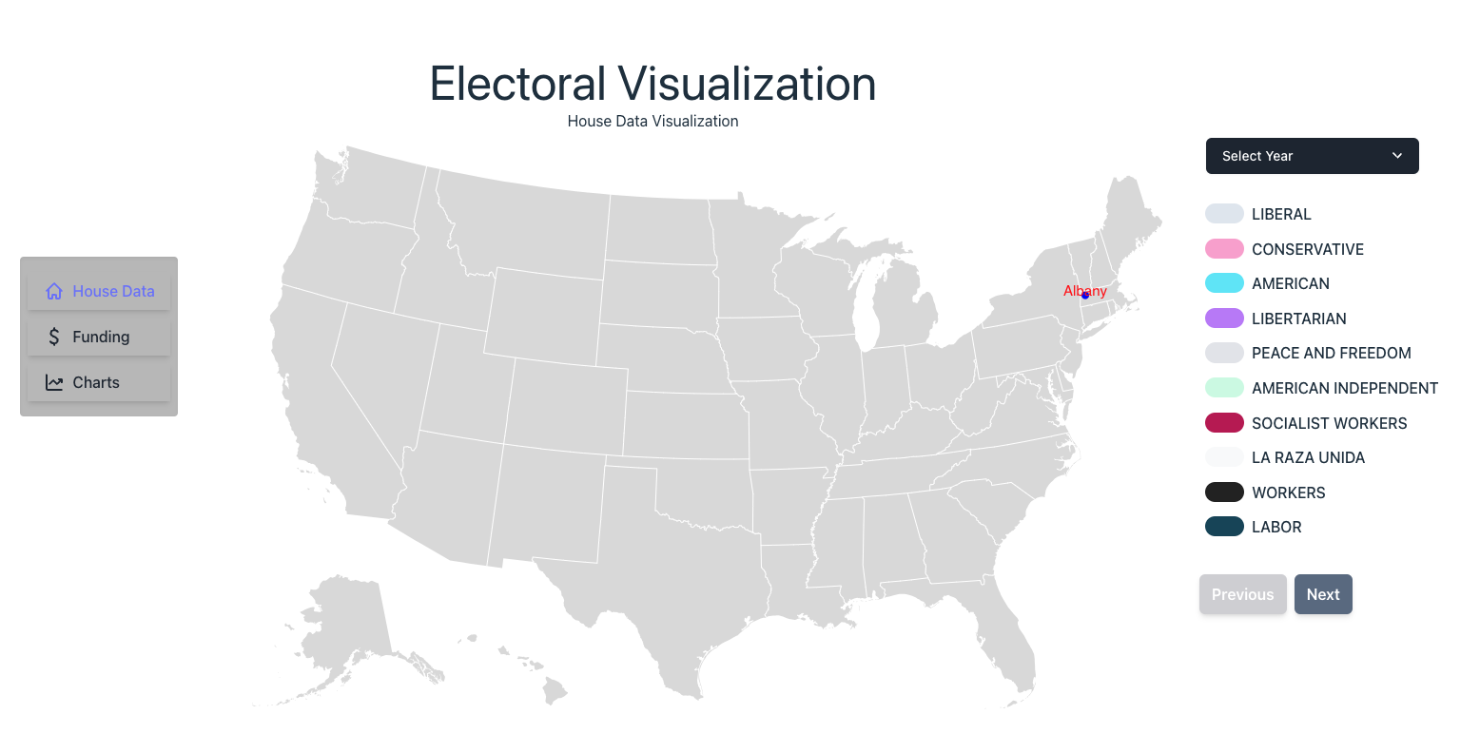

Slide 13
4. Results & Conclusion

Slide 14
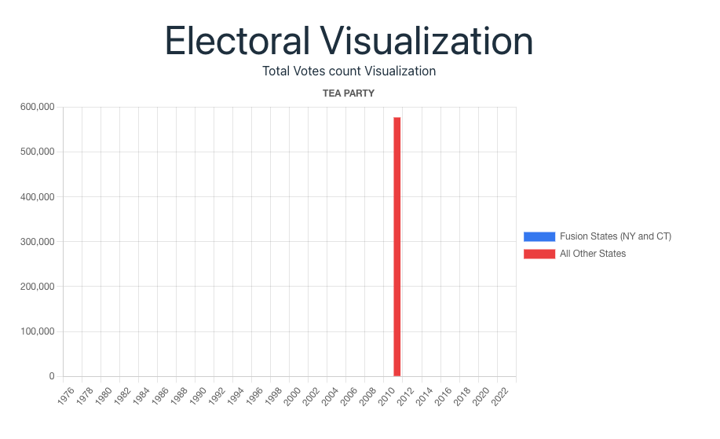
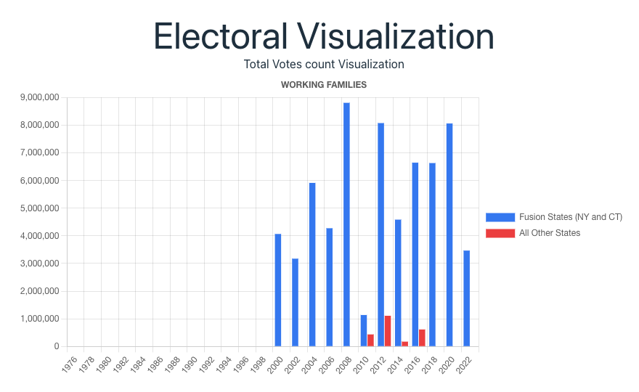
Results & Findings
Third parties in fusion states vs non-fusion states: Third parties that use fusion voting in NY have a longer lifespan than most other third parties in non-fusion states.
Notes:
Our analysis of third parties is a groundbreaking and innovative issue that has never been studied at a national scale. We will present our findings to a wide range of audiences, including political pundits, funders, reporters, academics, and operatives interested in electoral reform. For deliverables, we will incorporate three types of visualizations: a time-series visualization, a state-by-state visualization, and a third-party comparison visualization. With our visual aids, we can effectively communicate our insights to our audience, even those without an analytical background.

Slide 15
Results & Findings
The % of Votes for Third Parties (House Data): Third parties that work in both fusion and non-fusion states see significantly less vote share in non-fusion states.
Small Dollar Support (Funding): New York, the primary state where fusion voting is used, saw an increased level of small donor donations relative to its population compared to non-fusion states.
New York had roughly the same total amount of small donor donations as Pennsylvania, a state with 4 million more people and more electorally competitive. Although these findings cannot be solely attributed to fusion voting (other conditions like campaign finance may be considered), it is an interesting lens into state level differences.
Notes:
Our analysis of third parties is a groundbreaking and innovative issue that has never been studied at a national scale. We will present our findings to a wide range of audiences, including political pundits, funders, reporters, academics, and operatives interested in electoral reform. For deliverables, we will incorporate three types of visualizations: a time-series visualization, a state-by-state visualization, and a third-party comparison visualization. With our visual aids, we can effectively communicate our insights to our audience, even those without an analytical background.

Slide 16
Conclusion: Future Experiments
Layer the features and filters for a deeper analysis: For example, it would be interesting to see dollars donated by a specific party in a specific state or votes per party in each state.
Ability to download data from the visualization: After choosing a specific year and party, being able to download that small segment of data.
Connect policies passed to third party activity: The impact of third parties could also be measured by looking at legislative effectiveness in states with and without fusion.
Notes:
Our analysis of third parties is a groundbreaking and innovative issue that has never been studied at a national scale. We will present our findings to a wide range of audiences, including political pundits, funders, reporters, academics, and operatives interested in electoral reform. For deliverables, we will incorporate three types of visualizations: a time-series visualization, a state-by-state visualization, and a third-party comparison visualization. With our visual aids, we can effectively communicate our insights to our audience, even those without an analytical background.

Slide 17
Conclusion: Benefits of the Analysis
Innovative Issue Area: Political scientists have studied third parties, but they have not considered the effect of fusion voting after the 1900s in the United States on third parties.
Audience: This analysis has not been done on a national scale, and the audience will be political pundits, funders, reporters, academics, and operatives interested in electoral reform.
Specifications: Audience members typically do not have an analytical background so visualization is the most persuasive tool.
Deliverables: three types of visualizations – 1) time-series visualization, 2) state-by-state visualization, 3) third party comparison visualization
Notes:
Our analysis of third parties is a groundbreaking and innovative issue that has never been studied at a national scale. We will present our findings to a wide range of audiences, including political pundits, funders, reporters, academics, and operatives interested in electoral reform. For deliverables, we will incorporate three types of visualizations: a time-series visualization, a state-by-state visualization, and a third-party comparison visualization. With our visual aids, we can effectively communicate our insights to our audience, even those without an analytical background.

Slide 18
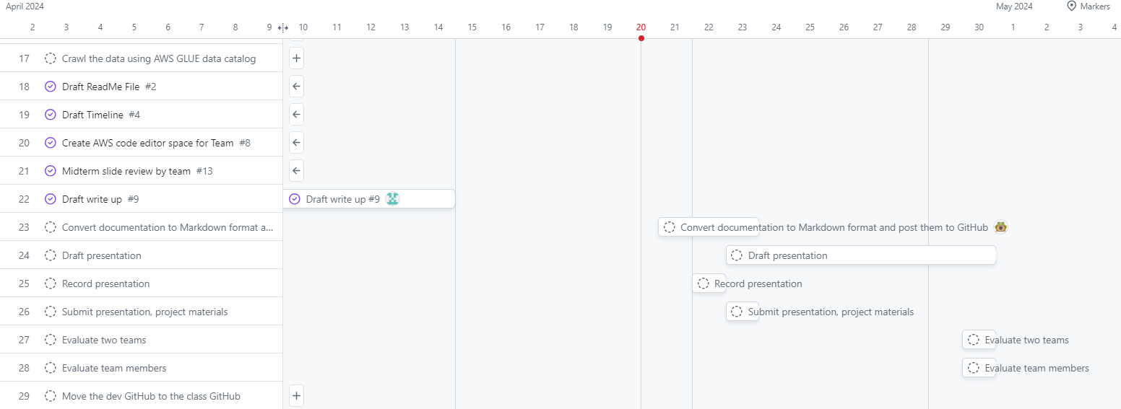
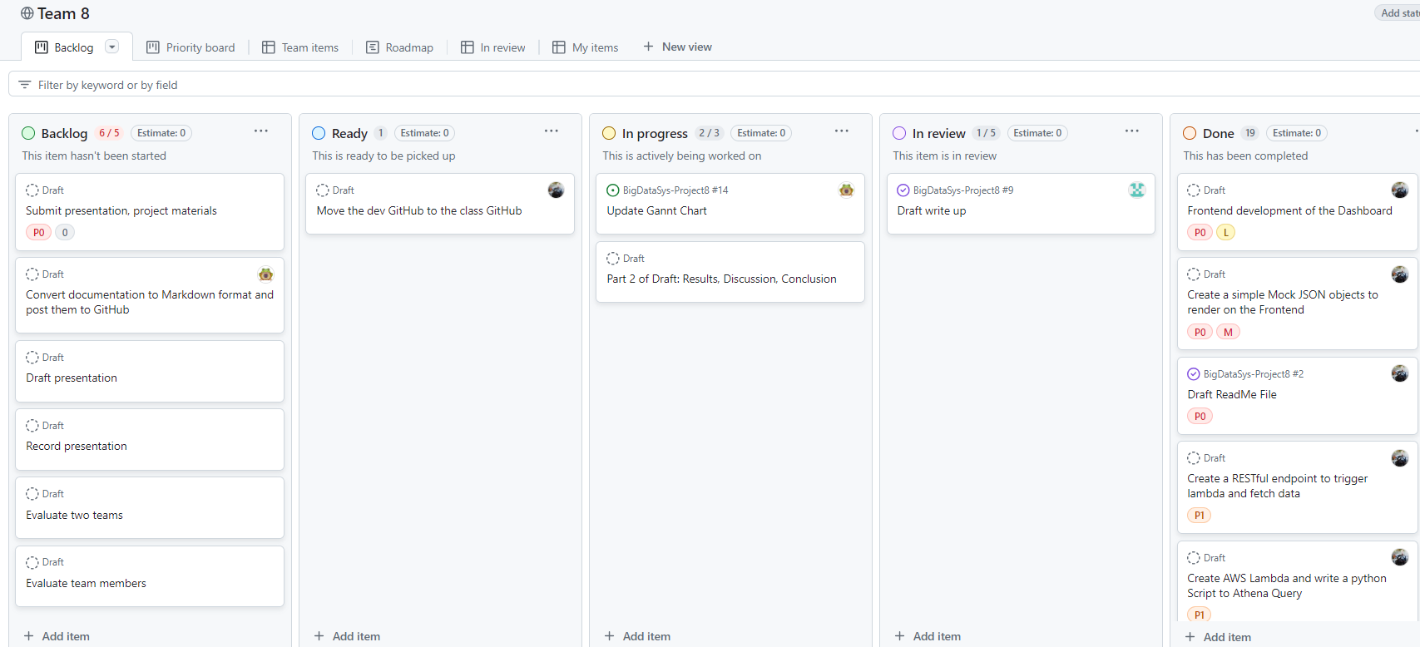
Project Management
GitHub Project
Team 8 GitHub:
https://github.com/UVA-MLSys/Big-Data-Systems/tree/main/Team%208

Slide 19
References
MIT Election Data and Science Lab, 2017, "U.S. House 1976–2022", https://doi.org/10.7910/DVN/IG0UN2, Harvard Dataverse, V13, UNF:6:Ky5FkettbvohjTSN/IVldA== [fileUNF]
Money Spent & Individual Contributions to Candidates: FEC Data (U.S. House, 1976-2022), https://www.fec.gov/data/receipts/individual-contributions/?two_year_transaction_period=2024&min_date=01%2F01%2F2023&max_date=12%2F31%2F2024
Election Outcome & Total Votes: MIT Data (U.S. House, 2008-2022),
https://electionlab.mit.edu/data

